Slide 1




TEAM NAME:
Quantum Dynamos
TOPIC: SMART GOVERNANCE
TEAM MEMBERS:
Manasvi H
Madam Chetty Shreya Datta
Monika C V
Sushma Subramanya K

Slide 2
Problem Statement: “Citizens struggle to navigate complex government processes and access services efficiently.”
• Navigating Complexity: Government processes are often intricate, involving numerous steps, forms, and regulations, making it difficult for citizens to understand and comply.
• Time-Consuming Procedures: Applications, approvals, and inquiries can take weeks or even months, causing delays and frustration for citizens.
• Limited Accessibility: Traditional service channels often have limited hours, long wait times, and accessibility challenges for certain populations.
• Information Scarcity: Finding accurate and up-to-date information about government services can be a daunting task, leading to confusion and misinformation.
• Lack of Personalization: Generic responses and a one-size-fits-all approach fail to address the specific needs and circumstances of individual citizens.
• Communication Barriers: Language differences, technical jargon, and a lack of clear communication can create obstacles for citizens trying to access services.
• Digital Divide: Not all citizens have equal access to technology or the digital literacy skills needed to navigate online government portals.

Slide 3
Solution: “CityBot: Empowering Citizens Through Al”
1. 24/7 Availability: CityBot provides instant support and answers to citizen inquiries around the clock, eliminating the constraints of traditional office hours.
2. Conversational Interface: An intuitive, natural language interface allows citizens to interact with government services using simple, everyday language, making the process accessible to everyone.
3. Personalized Guidance: CityBot offers tailored assistance based on individual needs, guiding citizens through specific processes and providing relevant information.
4. Simplified Processes: Complex procedures are broken down into easy-to-follow steps, simplifying applications and reducing the burden on citizens.
5. Centralized Information: CityBot serves as a single point of access for all government service information, eliminating the need to search through multiple websites or contact different departments.
6. Multilingual Support (Optional): CityBot can be designed to support multiple languages, ensuring inclusivity and accessibility for diverse communities.
7. Integration with Government Systems: CityBot can connect to backend systems to retrieve real-time information, process applications, and even perform transactions on behalf of citizens.

Slide 4
Tech Architect: Key Components and Connections
1. User Interface:
• Description: The interface through which citizens interact with the chatbot.
• Technology: HTML, CSS, JavaScript (for web chat); platform-specific technologies for mobile apps (e.g., Swift for iOS, Kotlin for Android).
2. Azure Bot Service:
• Description: The core platform for building, deploying, and managing the chatbot. Hosts the bot logic and handles communication with other services.
• Technology: Azure Bot Service (Web App Bot or Bot Channels Registration).
3. Bot Logic :
• Description: The code you write to define the chatbot's behavior, handle user input, manage conversations, and interact with LUIS and other services.
• Technology: C# or Node.js

Slide 5
4. Language Understanding (LUIS):
• Description: The Al service that enables the chatbot to understand natural language, interpret user intent, and extract entities.
• Technology: Azure Cognitive Services -Language Understanding (LUIS).
5. Data Storage (Mock or Real):
• Description: Where the chatbot stores data, such as conversation history, user preferences, or information retrieved from government systems (if integrated).
6. Government Systems Integration (Potential):
• Description: Connection to backend government systems to retrieve information, process applications, or perform transactions.
• Technology: APIs (REST, SOAP), database connections, or other integration methods.

Slide 6
Microsoft Azure Components and Their Roles:
1. Azure Bot Service: This is the foundational platform for building, deploying, and managing the chatbot. Think of it as the "container" that hosts the chatbot's logic and provides the framework for interaction.
It handles:
• Hosting: Provides the infrastructure to run the chatbot.
• Connectivity: Enables the chatbot to connect to various communication channels (e.g., web chat, messaging apps).
• Management: Offers tools to manage and monitor the chatbot's performance.
2. Azure Cognitive Services (Language Understanding - LUIS): This service empowers the chatbot with natural language understanding (NLU) capabilities. It's the "brain" that allows the chatbot to:
• Understand Natural Language: Interpret what citizens type or say, even if it's not perfectly grammatically correct.
• Interpret User Intent: Figure out what the citizen wants to achieve (e.g., report a pothole, get information about parking).
• Provide Relevant Responses: Based on the understood intent, deliver appropriate and helpful information or actions.

Slide 7
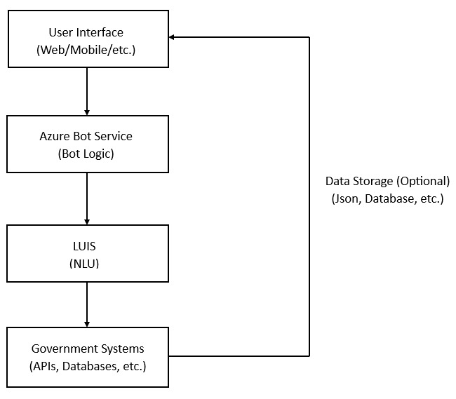
Tech Diagram:
GitHub Repo Link:
https://github.com/manasvi053/AInnovation-Qunantum_Dyanmos

